Slide 1
Analyzing Audio Features Top tracks of the most popular artists
Using the Spotify API and scraping Billboard.com (2010 – 2018)

Slide 2
Project Goal
Perform exploratory data analysis on the key audio features for top songs being produced by leading artists
Visualize correlation between song attributes of the most popular artists to understand what makes their music popular

Slide 3
Keys Steps to Achieve the Goal
Scrape top 100 artists from Billboard.com (2010-2018)
Use Spotify API to get their artist ID, top 10 songs, and audio features for each song
Import all the data into pandas DataFrame for analysis and visualizations
Create data visualizations and find key insights

Slide 4
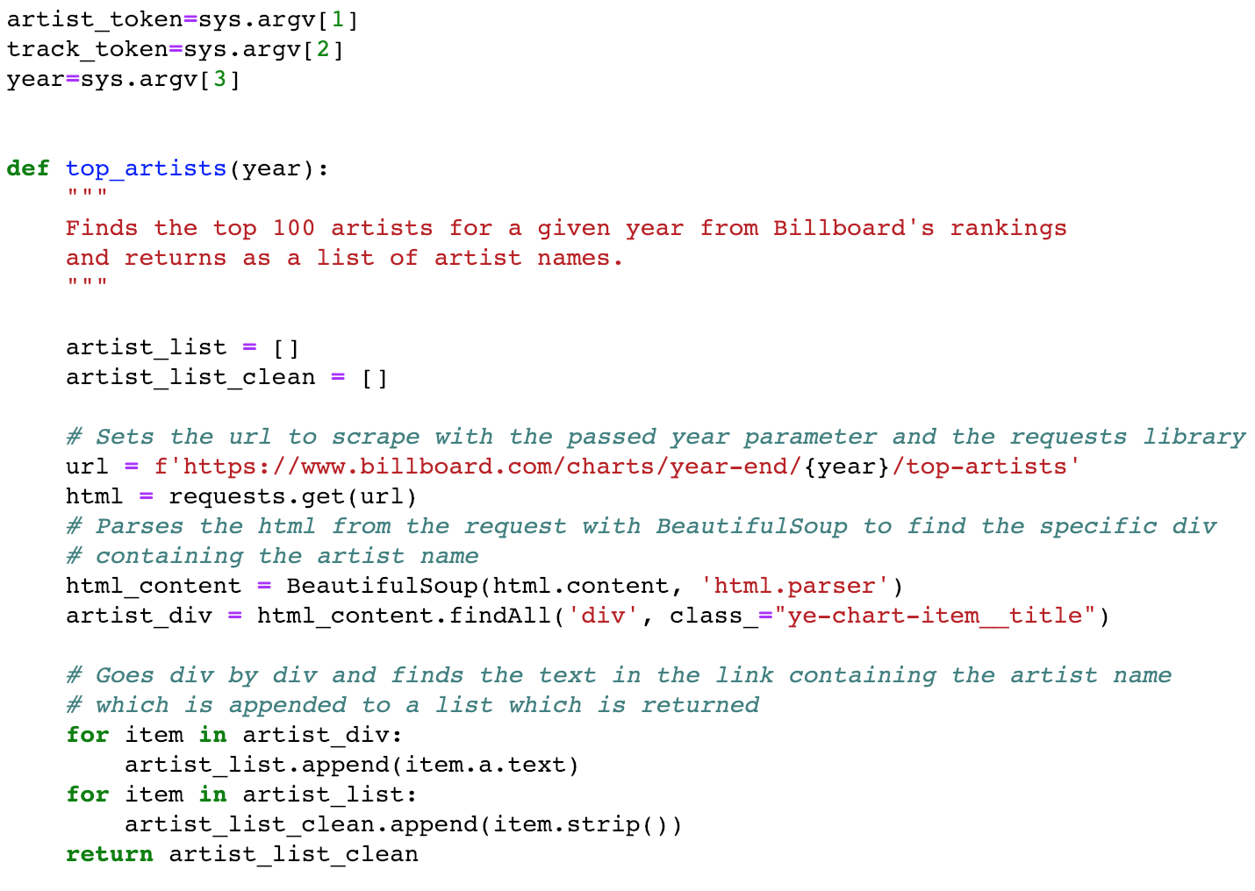
Billboard.com – Web Scraping
Scraped top 100 artists for each year from 2010 – 2018

Slide 5
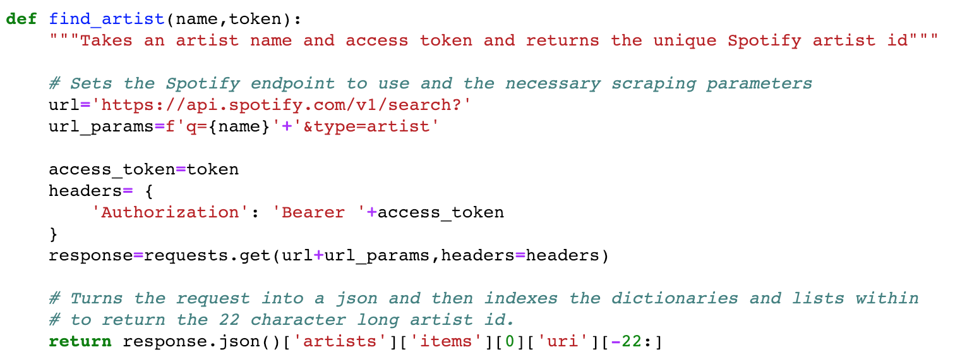
Get Artist ID from the Spotify API
Passing name of the artist to the function returns the Spotify ID

Slide 6
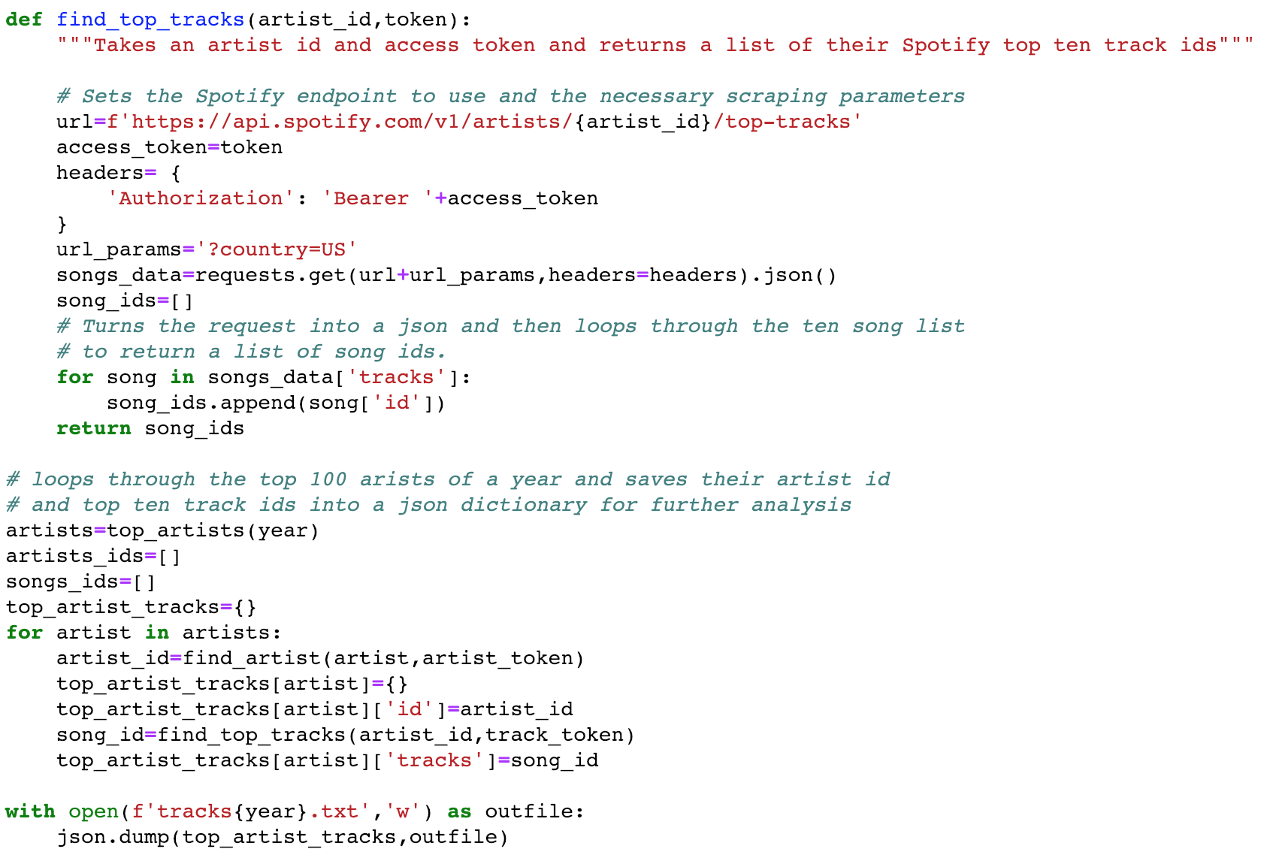
Get Artists’ Top 10 Tracks from Spotify API
Artist IDs extracted previously are used to get the top 10 tracks for each artist
Output of top 10 tracks for 100 artists for each year is saved as a JSON file

Slide 7
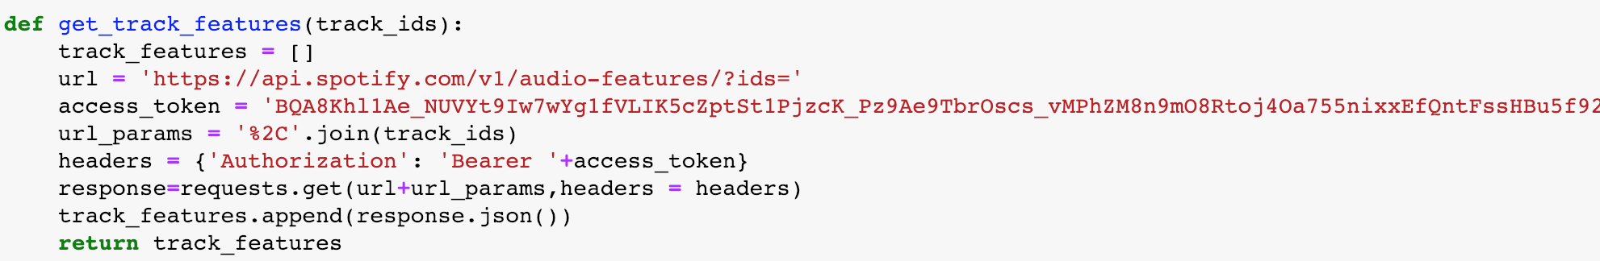
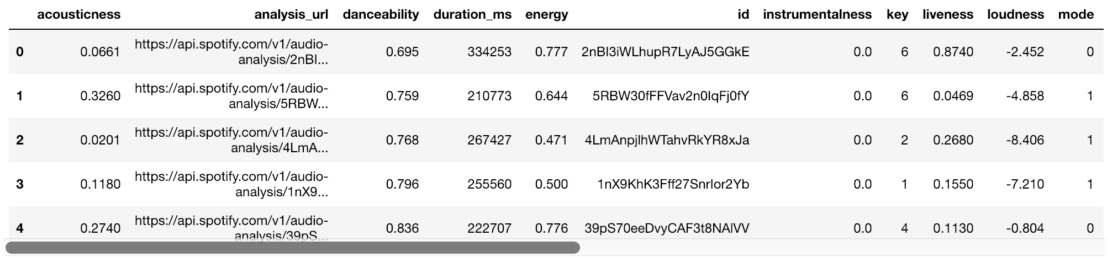
Get Audio Features for Each Song from Spotify
Audio features include:
Valence, “Danceability”, Energy, Loudness, “Acousticness”, “Speechiness”, “Instrumentalness”
Example of audio features data:

Slide 8
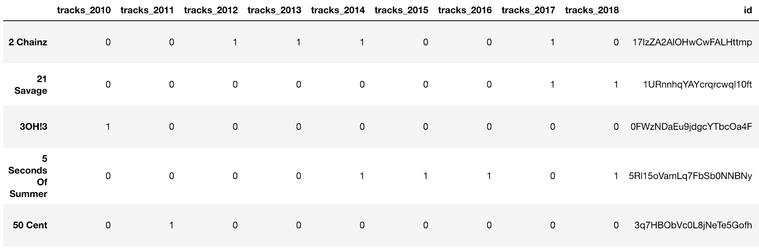
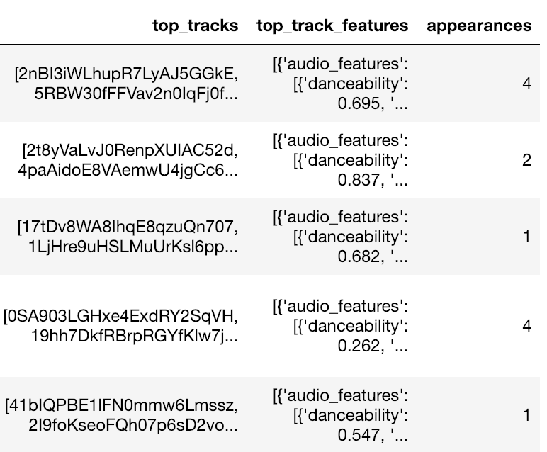
Bring It All Together for Analysis
Merged multiple dataframes (2010-2018) to collect features for each artist
1/0 – if they were a top 100 artist in each year
the artist id
top 10 track ids
audio features for their top 10 tracks
count of appearances in the top 100 for each year
369 unique artists appeared over the last 9 years
Top 10 songs for each artist gives us information about 3,690 unique songs for analysis

Slide 9
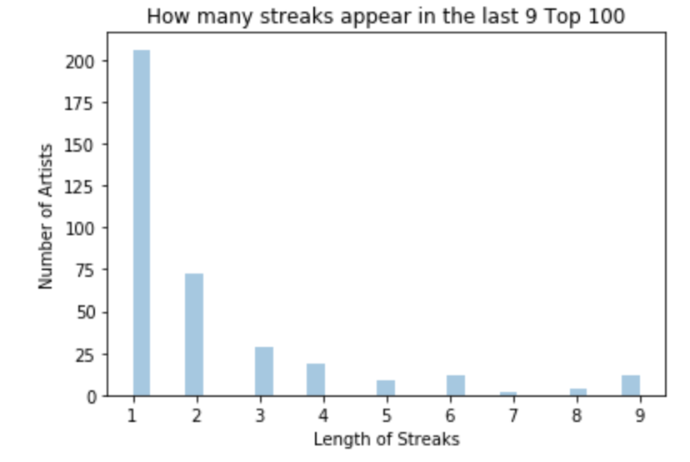
Exploratory Data Analysis (EDA)
Looking at artist recurrence over the last nine years shows that most artists appeared in the Top 100 only once but there are artists that repeat in the top 100 list over multiple years
There are 12 artists that made it to the top 100 for all 9 years.

Slide 10
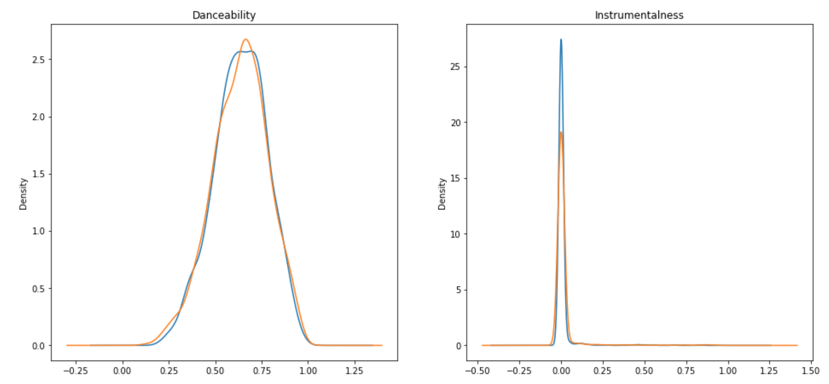
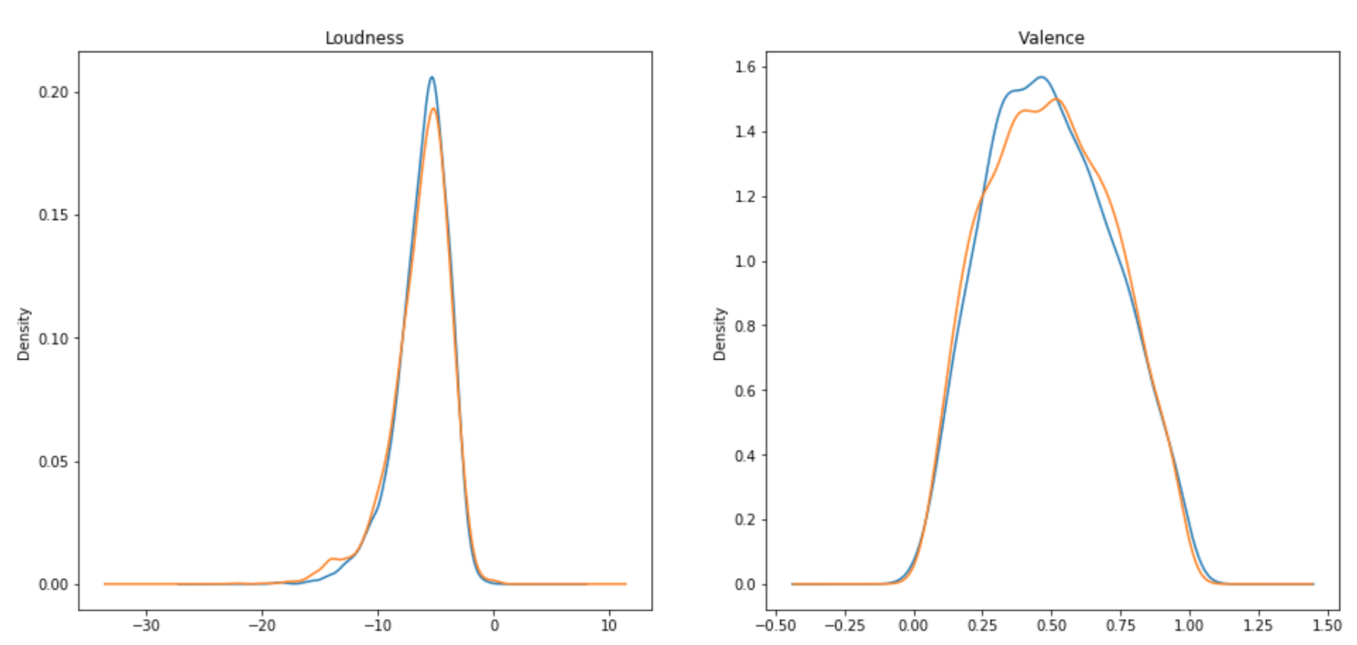
Comparing Superstars vs Others
Comparing the songs produced by both groups (artists who recurred in the top 100 and those who only appeared once) show a clear lack of distinction
All artists that make it to the top 100 list seem to have similarities in their audio features

Slide 11
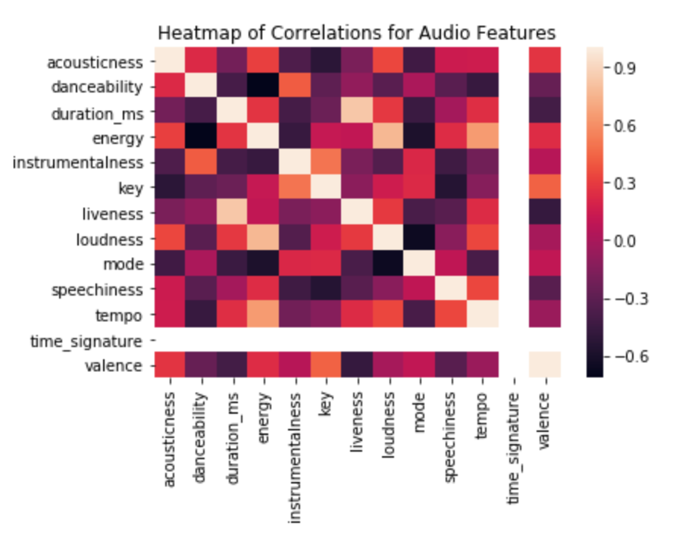
Correlations between Audio Features
This is a heatmap where the color intensity represents degree of correlation
(light colors – more positive; dark colors – more negative)
There are some interesting correlations between features that we will explore further in the following slide

Slide 12
Scatter Plots of Key Audio Features

Slide 13
Summary and Next Steps
Top songs produced by leading artists tend to be:
High scoring on: valence, loudness, energy and “danceability”
Low scoring on: “acousticness”, “instrumentalness”, and “speechiness”
Next steps could include:
Compare top 100 artists with random sampling of other artists to identify unique features of top artists
Compare top 10 songs with other songs from the same artist to compare trends of top songs within a discography
Potentially explore other data sets to enrich current data with metrics such as playlist occurrences, lyrical content, genre, and streams

